Slide 1
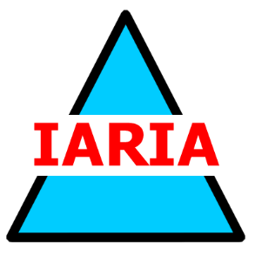
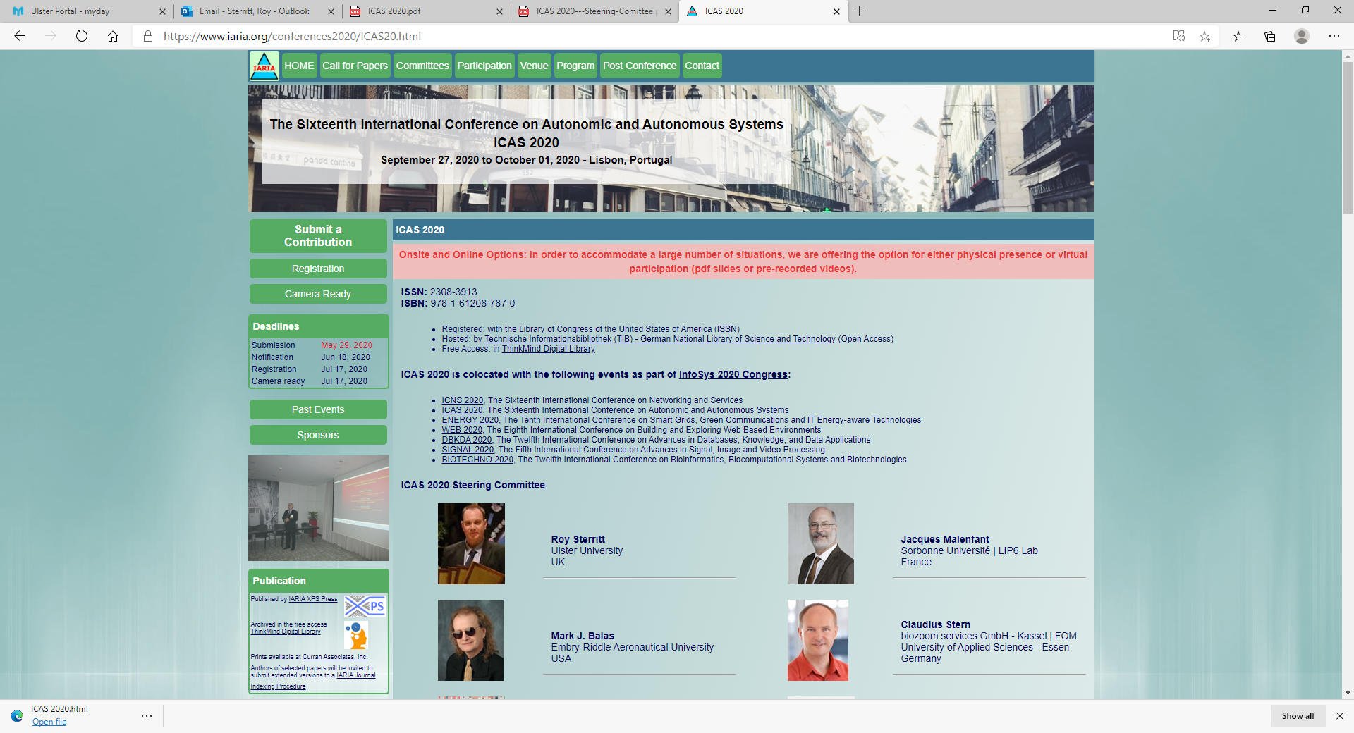


Panel 4
Cloud Technologies: Connected and Unconnected, yet Processing
(cloud technological impact, service reliability, challenges for data and processes, trusted and secured environments, etc.)
Computation
World
2020
Panellist Position
The Complexities of Modern Cloud and the Impact on Compliance
Bob Duncan, University of Aberdeen, bobduncan@abdn.ac.uk
Cloud security
Corporate compliance
Blockchain and the forensic trail
Accountability
IoT security is hard to balance due to complexity and untrained users
Removing a need for centralized control of security is an opportunity for distributed systems
→ Autonomous Systems require Autonomous Security

Slide 2
Panel 4
Cloud Technologies: Connected and Unconnected, yet Processing
(cloud technological impact, service reliability, challenges for data and processes, trusted and secured environments, etc.)
Computation
World
2020
Outline
Cloud Technologies
Connected and Unconnected, yet Processing
Cloud technological impact
Service reliability
Challenges
Data and processes
Trusted and secured environments
Compliance with legislation and regulation

Slide 3
Panel 4
Cloud Technologies: Connected and Unconnected, yet Processing
(cloud technological impact, service reliability, challenges for data and processes, trusted and secured environments, etc.)
Computation
World
2020
Cloud Technologies
Cloud started as a simple suite of outsourced tools
IaaS, PaaS or SaaS
Service reliability was reasonable, security and privacy less so
Now we have more things as a Service than can possibly fit on this page
We can even have a cloud of clouds as a Service
What started as three simple either/or options is now a mixture of combinations
With included and excluded components, this equals more comlpexity

Slide 4
Panel 4
Cloud Technologies: Connected and Unconnected, yet Processing
(cloud technological impact, service reliability, challenges for data and processes, trusted and secured environments, etc.)
Computation
World
2020
Connected and Unconnected, yet Processing
Cloud can be permanently connected, and processing
Cloud can be occasionally connected, and processing
Cloud can incorporate remote processing of data
Cloud can incorporate intermittent connections for data processing
Cloud can do in-cloud processing
Cloud can store in-cloud, or can use external storage
Cloud can do connection by-request
Cloud can do any permutation of these

Slide 5
Panel 4
Cloud Technologies: Connected and Unconnected, yet Processing
(cloud technological impact, service reliability, challenges for data and processes, trusted and secured environments, etc.)
Computation
World
2020
Cloud technological impact
Cloud offers rapid spooling up of new technology
Cloud offers major reductions in capital investment requirements
Cloud can offer major reductions in the need for large premises
Cloud can offer high flexibility in change for new markets
Cloud offers fast expanding startups the ability to complete with global corporates

Slide 6
Panel 4
Cloud Technologies: Connected and Unconnected, yet Processing
(cloud technological impact, service reliability, challenges for data and processes, trusted and secured environments, etc.)
Computation
World
2020
Service reliability
Service reliability was the initial major selling point for cloud
That is still high, where one service provider is delivering the service
When multiple service companies are involved, this can be compromised
This can lead to slackness in some service providers “It wasn’t my fault, it was these other companies who did not …”
On the plus side, those offering poor service tend not to be in business for long
On the other hand, if you are relying on their service and get poor reliability….

Slide 7
Panel 4
Cloud Technologies: Connected and Unconnected, yet Processing
(cloud technological impact, service reliability, challenges for data and processes, trusted and secured environments, etc.)
Computation
World
2020
Challenges
Dealing with the complexities on offer can be challenging
Coping with multiple service providers can lead to issues
Ensuring proper security and privacy can still be a challenge
Proper accountability where multiple service providers are involved
Keeping track of data collected can be a problem
The more complex your setup is, the more challenges you have

Slide 8
Panel 4
Cloud Technologies: Connected and Unconnected, yet Processing
(cloud technological impact, service reliability, challenges for data and processes, trusted and secured environments, etc.)
Computation
World
2020
Data and processes
Data is at the core of compliance with legislation and regulation
Once multiple service providers are involved, this needs proper control
With non-permanent connections, keeping proper track of the data is hard
Keeping track of processes that are both in-cloud and external is also hard
The more complexity that is possible = the more challenging it all becomes

Slide 9
Panel 4
Cloud Technologies: Connected and Unconnected, yet Processing
(cloud technological impact, service reliability, challenges for data and processes, trusted and secured environments, etc.)
Computation
World
2020
Trusted and secured environments
Large service providers are usually very ‘switched on’ on as far as trust and security are concerned, typically less so for smaller service providers
Usually very well documented in the service level agreement
They must be accountable for their actions, without ‘get-out’ clauses in the service level agreements
Again, this is fundamental to the ability for the cloud user to achieve compliance with the relevant legislation and regulation

Slide 10
Panel 4
Cloud Technologies: Connected and Unconnected, yet Processing
(cloud technological impact, service reliability, challenges for data and processes, trusted and secured environments, etc.)
Computation
World
2020
Compliance with legislation and regulation
Cloud users are accountable to the legislative and regulatory authorities for ensuring they can demonstrate compliance
Cloud users cannot ‘pass the buck’ to service providers as an excuse for any failures or shortcomings
Using a complex cloud service structure could make compliance far less transparent, which can lead to issues with the regulators
Cloud users who get it wrong are likely to face punitive action by the regulators, especially if they are negligent

