Slide 1

3D Data Visualization Using a Spherical Display
Cognitive Humane-Machine Interaction at Work
Digital World 2020
Oky Dicky Ardiansyah Prima
Email: prima@iwate-pu.ac.jp
Department of Software and Information Science
Iwate Prefectural University, Japan.

Slide 2
Our lab has been developing some computer-vision-related devices and applications, such as a 3D eye tracker based on convergence eye movements, automated behavior analysis during conversation, 3D motion analysis using a single camera, and a 3D perspective-corrected spherical display. We will share our experience in visualizing the 3D data into a spherical display.

Slide 3
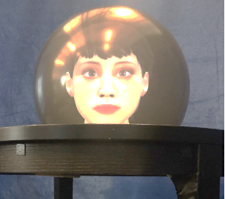
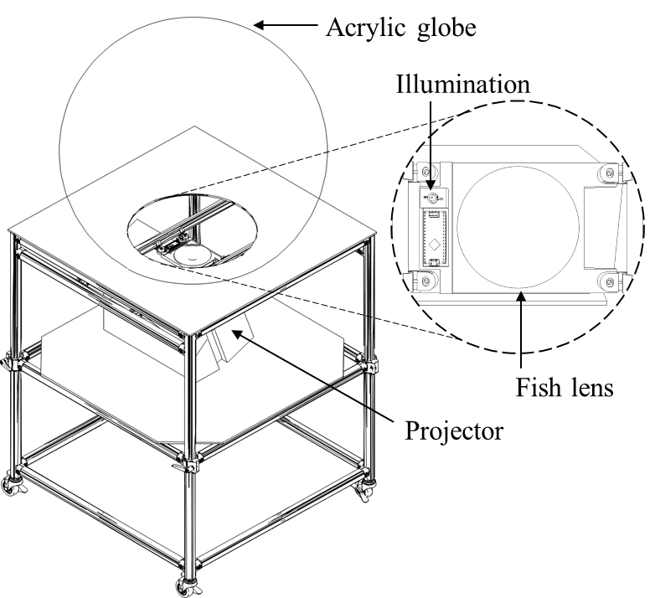

Introduction:: A 3D Perspective-Corrected Spherical Display
It was in 2018, when I took a sabbatical to the HCT-lab^{[1]} at the University of British Columbia, where I had an opportunity to work on a 3D perspective corrected spherical display. After I got back to Japan, I started building an affordable spherical display that has the same function as the HCT-lab's.
Eye contact with a virtual character ^{[2]}
Features implemented in our spherical display:
Stereoscopic 3D rendering (single viewpoint)
Motion-parallax 3D rendering (multi-viewpoint)
Touch interface
SDK for the Unity 3D
Our spherical display ^{[3]}
Digital World 2020

Slide 4
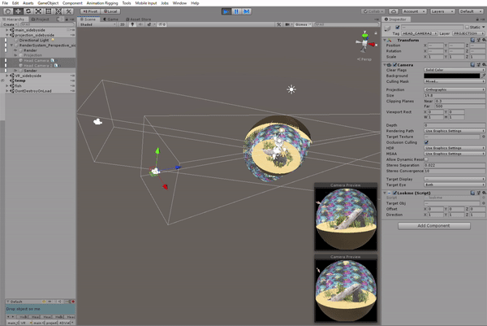

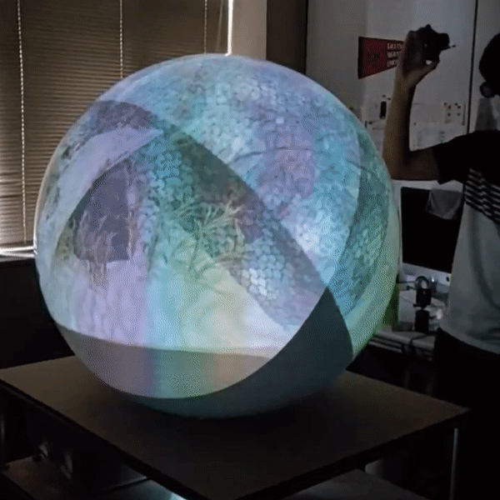
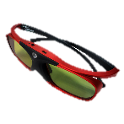
Introduction:: A 3D Perspective-Corrected Spherical Display
3D images are rendered in real-time according to the users’ viewpoints, which are tracked by a motion capture device.
Shutter glasses
Two viewpoints
3D rendering with the Unity 3D SDK (two viewpoints)
Digital World 2020

Slide 5
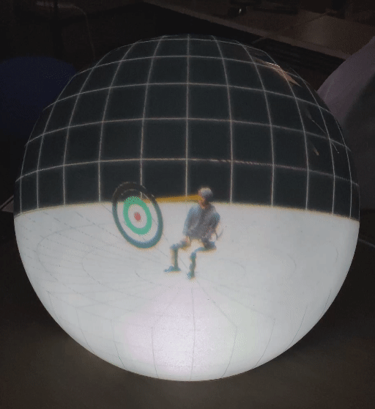
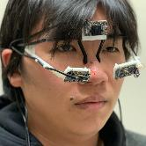
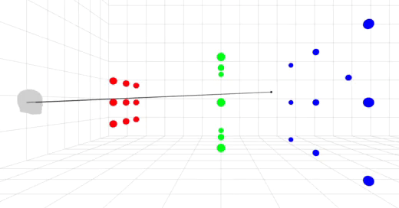
Applications:: 3D eye tracker based on convergence eye movements
Our glass-type 3D eye tracker ^{[4]} consists of three webcams: one camera for capturing the scene and one camera for capturing the pupils of both eyes. The user's 3D eye-scanpaths can be visualized from various angles on the spherical display.
Our 3D eye tracker
3D scanpath of a user looking at a moving target
3D scanpath visualization in a 3D spherical display
Digital World 2020

Slide 6
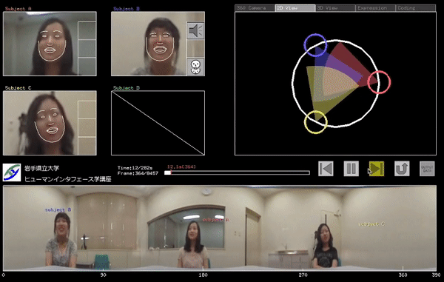
Applications:: Automated behavior analysis during conversation
We developed a software application program ^{[5]} to automatically analyze behaviors of the participants including utterances, facial expressions (happy or neutral), head nodding, and head pose using a single omnidirectional camera.
Digital World 2020

Slide 7
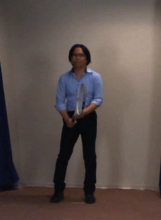
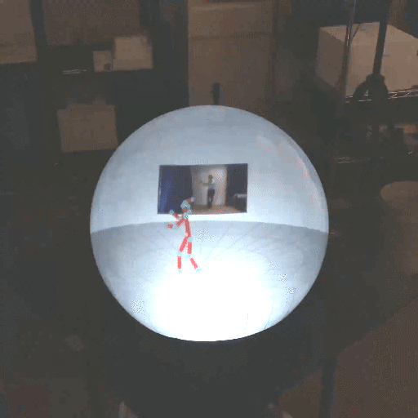
Applications:: 3D motion analysis using a single camera
We visualized 3D human skeletons based on 3D human body pose estimation from a single vision camera. The results demonstrated that the vision camera has an advantage over the Microsoft Kinect for estimating semi-occluded joint positions ^{[6]}.
Digital World 2020

Slide 8
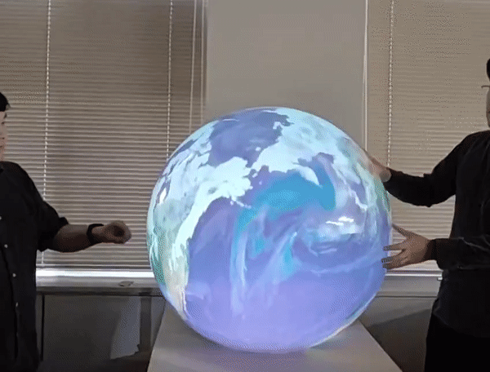
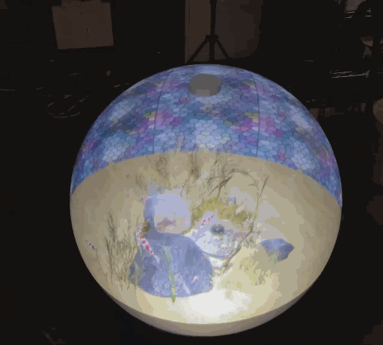
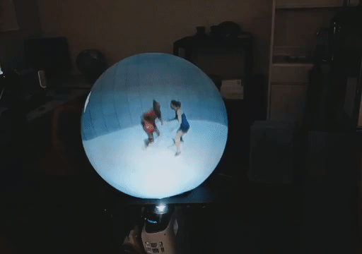
Concluding Remarks
3D spherical display has the potential to visualize a variety of 3D contents, such as volumetric data, motion capture data, virtual fish-tank, and 3D digital globe. The multi-view feature allows users to observe the same object from various angles at the same time.
In the future, we will enhance its feature to enable a virtual surgical .
3D digital globe
Virtual fish-tank
Volumetric data
Digital World 2020

Slide 9
References
Human Communication Technology laboratory, https://hct.ece.ubc.ca/
G. Hagemann, Q. Zhou, I. Stavness, O. D. A. Prima, and S. S. Fels, “Here’s looking at you: A Spherical FTVR Display for Realistic Eye-Contact,” ISS 2018 - Proceedings of the 2018 ACM International Conference on Interactive Surfaces and Spaces, 357–362. 2018. https://doi.org/10.1145/3279778.3281456
R. Takahashi, K. Hotta, O. D. A. Prima, and H. Ito, “A Perspective-Corrected Stylus Pen for 3D Interaction,” The 13th International Conference on Advances in Computer-Human Interactions (ACHI2020), Special Track on Human Computer Interaction and Behavior Analysis Using Vision Cameras, Valencia, Spain, 2020.
K. Kato, O.D.A. Prima, H. Ito, “3D Eye Tracking for Visual Imagery Measurements,” In: Stephanidis C. (eds) HCI International 2019 - Posters. HCII 2019. Communications in Computer and Information Science, vol 1033. Springer, Cham., 2019. https://doi.org/10.1007/978-3-030-23528-4_32
Y. Jaana, O.D.A. Prima, T. Imabuchi, H. Ito, and K. Hosogoe, “The development of automated behavior analysis Software,”Proc. SPIE 9443, Sixth International Conference on Graphic and Image Processing (ICGIP), 2014.
O. D. A. Prima et al., “Evaluation of Joint Range of Motion Measured by Vision Cameras,” International Journal on Advances in Life Sciences, issn 1942-2660, 11, 3&4, 128-137, 2019.
Digital World 2020

